Slide 1
A101 Science
Problem 02: Strange Actions
6th Presentation
Copyright © 2010

Slide 2
Steps taken to understand phenomena
Step 1: Making observations
Step 2: Drawing conclusions from observations
Step 3: Making predictions

Slide 3






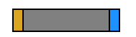





Program1.exe
Observations
The yellow box does not have any arrow when there is no object or when NGB is present.
When object GB is present, the yellow box shows an arrow. The direction of this arrow depends on the position of the yellow box.
Notes:
3

Slide 4
Program1.exe
Conclusions
The effect on the yellow box when NGB is present is the same as when there is no object.
The arrow in the yellow box responds to GB. This could be due to a special property that GB possesses but NGB lacks.
Prediction
When BG is present, the arrow in the yellow box should point in the opposite direction to the scenario when GB is present.
Notes:
4

Slide 5


Program2.exe
Observations
1. When no object is selected : No Effect on yellow box and Detector
2. When AU is selected :
3. When AD is selected :
The right side of the Detector will light up.
The arrow in the yellow box around S responds as if it is around GB.
The left side of the Detector will light up.
The arrow in the yellow box around S responds as if it is around BG.

Slide 6
Program2.exe
Conclusions
When AU is present:
  A flow is detected.
  The presence of this flow resulted in S having the same effect on the yellow box as GB.
When AD is present:
  A flow in the opposite direction is detected.
  The presence of this flow resulted in S having the same effect on the yellow box as BG.
When AU or AD is present with S, the effect is similar to that observed in Program1.exe.
Notes:
6

Slide 7
Program3.exe
Observations
Effects on the Detector :
No change when NGB, GB and BG are stationary.
A greater intensity (darker red) is observed when the speed of GB or BG is increased.
Moving object | Direction of movement | Side of Detector that lights up
NGB | A→B; C←D A←B; C→D
GB | A→B; C←D
GB | A←B; C→D
BG | A→B; C←D
BG | A←B; C→D
Conclusions
Moving GB or BG creates a flow through S similar to having AU or AD present.
S behaves like GB or BG when that happens.

Slide 8


Another behaviour of GB and BG
It is given that B-B ends and G-G ends repel each other while G-B ends and B-
G ends attract each other.
Repulsion | Attraction
Hence, if S is made to behave like GB, we can predict that it can attract object GB when placed near it.
G B
S
GB is attracted to S
Notes:
8

Slide 9

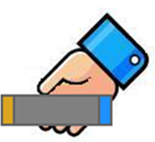

Making predictions
The effect of moving GB or BG (in Program3.exe) on the Detector can be increased or reduced by the movement of another object GB or BG.
Two examples are given below:
Effect increased
(Detector intensity increased)
Effect decreased
(Detector intensity decreased)

Slide 10
Learning points
To explain the phenomena observed in the programs, we took the following steps:
Consider one program at a time
Make observations
  E.g. Arrow in yellow box appears when GB is selected in Program 1.
Repeat for Program 2 and Program 3
Draw conclusions from observations
  E.g. GB has a special property which influences the behaviour of the yellow box.
Make predictions
  E.g. Arrow will point in the opposite direction when BG is selected.
Draw conclusions for
all 3 programs

Slide 11
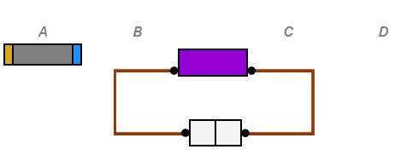

Discussion
  Move GB towards Set-up X.
  Move GB away from Set-up X.
  Replace GB with BG and move BG towards
  Set-up X.
  d) Replace GB with BG and move BG away from
  Set-up X.
  e) Move GB and Set-up X in the same direction with the same speed.
  f) Move Set-up X away from GB without moving GB.
Given the set-up on the right, what
could be done to cause the right side
of the Detector to light up?
(You may select more than one
answer)
GB
S
Set-up X

